Slide 1
Addressing Modes, Table, User Stack

Slide 2
Address Mode
Table
Stack and Subroutine Call

Slide 3
Address Mode
Table
Stack and Subroutine Call

Slide 4
Introduction
Data (source and destination) could be in
Register
Memory (data or program)
Immediate values (part of instruction)
PIC18 provides 4 addressing modes
  (The waysof accessing data is called addressing mode.)
Immediate
Direct
Register indirect
  Indexed-ROM
4
Notes:
4

Slide 5
Immediate and Direct Addressing mode
Add. Code
0000 0E56 MOVLW 0x56
0002 6E40 MOVWF 0x40, ACCESS
0004 C040 MOVFF 0x40, 0x50
0006 F050
0008 EF00 GOTO 0
000A F000
  56 →WREG
  WREG → loc 40H
  (Loc 40H)→loc 50H
5
Notes:
5

Slide 6
Immediate and Direct Addressing mode
What is the difference between
INCF fileReg, W
INCF fileReg, F
6
Notes:
6

Slide 7
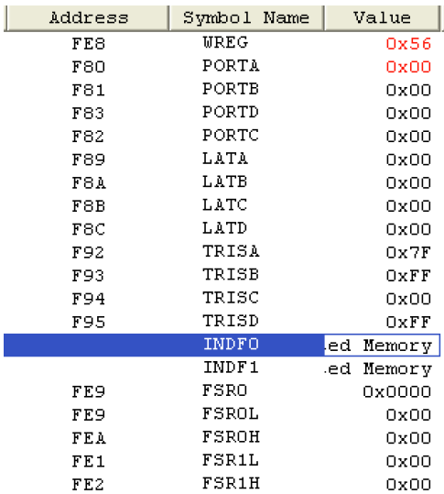
SFR Registers and their addresses
Can be access by Their name
Their address
Which is easier to remember?
MOVWF PORTB
MOVWF 0xF81
7
Notes:
7

Slide 8
SFR Registers and their addresses
SFR addresses are started at F80H and the last location is the address FFFH
In Listing file, you will see that the SFR names are replaced with their addresses.
The WREG register is one of the SFR registers and has address FE8h
0000 0E56 MOVLW 0x56 ; MOVLW 56H
0002 6E81 MOVWF 0xf81, ACCESS ; MOVWF PORTB
8
Notes:
8

Slide 9
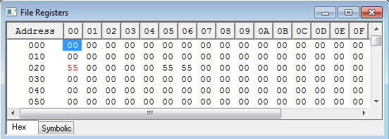
Register indirect Addressing mode
A register is used as a pointer to the data RAM location.
In PIC18 Three 12-bit Registers are used (from 0 to FFFh)
FSR0, FSR1, FSR2, Each register is associated with INDFx (shadow registers for using FSRn)
MOVFW INDF0 (move the WREG to the location pointed by FSR0)
cblock 0x020 data_table: 5 R1 R2 endc | Main ORG 0x0000 LFSR 0, data_table ; FSR0=020h movlw 0x55 movwf R1 movwf R2 movwf INDF0 Here goto here
9
Notes:
9

Slide 10
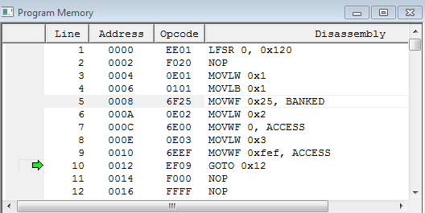
Register indirect Addressing mode
cblock 0x000 R2 endc cblock 0x120 data_table: 5 R1 endc | Main ORG 0x0000 LFSR 0, data_table ; FSR0=120h movlw 01H movlb high R1 movwf R1 movlw 02H movwf R2 movlw 03H movwf INDF0 Here goto here
R1 address = 125H
R2 address = 000H
data_table address = 120H
10
Notes:
10

Slide 11
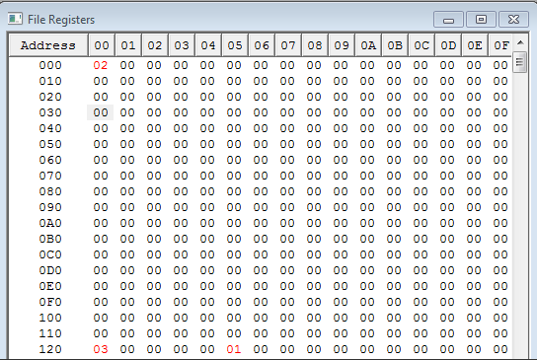
Register indirect Addressing mode
11
Notes:
11

Slide 12
Address Mode
Table
Stack and Subroutine Call

Slide 13
Tables
Indirect addressing makes accessing data dynamic. That is why we can implement array in high level language.
Looping is possible to increment the address in FSR with
XXXX stays for some instructions
Instructions
XXXX INDFn | After accessing fileREG pointed by FSFn, the FSRn is unchanged.
XXXX POSTINCn | After accessing fileREG pointed by FSFn, the FSRn is incremented
XXXX PREINCn | Before accessing fileREG pointed by FSFn, the FSRn is incremented.
XXXX POSTDECn | After accessing fileREG pointed by FSFn, the FSRn is decremented
XXXX PLUSWn | Address = WREG + FSRn
13
Notes:
13

Slide 14
Example
Write a program to copy the value 55H into RAM locations 40h to 45h using
Direct addressing mode
Register indirect addressing mode
A loop

Slide 15
Example
Solution B
MOVLW 55H
LFSR 0,0x40
MOVWF POSTINC0
MOVWF POSTINC0
MOVWF POSTINC0
MOVWF POSTINC0
MOVWF POSTINC0

Slide 16
Example
Solution C
LFSR 0, 0x040
MOVLW 0x5
MOVWF COUNT
MOVLW 0x55
B1 MOVWF POSTINC0
DECF COUNT,F
BNZ B1
Of course C is much better if the table size is large

Slide 17
Example
Write a program to clear 16 RAM location starting at location 60H using Auto increment.
COUNTREG EQU 0x10
CNTVAL EQU D'16'
MOVLW CNTVAL
MOVWF COUNTREG
LFSR 1,0x60
B3 CLRF POSTINC1
DECF COUNTREG,F
BNZ B3

Slide 18
Example
Write a program to copy a block of 5 bytes of data from location starting at 30H to RAM locations starting at 60H.
COUNTREG EQU 0x10
CNTVAL EQU D'5'
MOVLW CNTVAL
MOVWF COUNTREG
LFSR 0, 0x30
LFSR 1, 0x60
B3 MOVF POSTINC0,W
MOVWF POSTINC1
DECF COUNTREG,F
BNZ B3

Slide 19
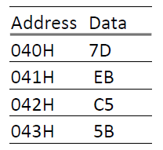
Example
Assume that RAM locations 40-43H have the following hex data. Write a program to add them together and place the result in locations 06 and 07.
COUNTREG EQU 0x20
L_BYTE EQU 0x06
H_BYTE EQU 0x07
CNTVAL EQU 4
MOVLW CNTVAL
MOVWF COUNTREG
LFSR 0,0x40
CLRF WREG
CLRF H_BYTE
B5 ADDWF POSTINC0, W
BNC OVER
INCF H_BYTE,F
OVER DECF COUNTREG,F
BNZ B5
MOVWF L_BYTE

Slide 20
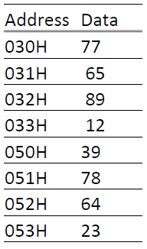
Example
Write a program to add the following multi-byte BCD numbers and save the result at location 60H. 12896577 +23647839
COUNTREG EQU 0x20
CNTVAL EQU D'4'
MOVLW CNTVAL
MOVWF COUNTREG
LFSR 0,0x30
LFSR 1,0x50
LFSR 2,0x60
BCF STATUS,C
B3 MOVF POSTINC0,W
ADDWFC POSTINC1,W
DAW
MOVWF POSTINC2
DECF COUNTREG,F
BNZ B3

Slide 21
Fixed Data in Program Space
ROM has enough space to store fixed data
DB directive, which means Define Byte, is widely used to allocate ROM program memory in byte-sized chunks
Use single quotes (´) for a single character or double quotes (“) for a string
Org 0x500
DATA1 DB 0x39
DATA2 DB `z´
DATA3 DB “Hello All“
XXXX stays for some instructions
21
Notes:
21

Slide 22
Fixed Data in Program Space
Program conter is 21-bit, which is used to point to any location in ROM space.
How to fetch data from the code space? Known as a table processing: register indirect ROM addressing mode.
To read the fixed data byte. We need an address pointer: TBLPTR: Points to data to be fetched
  21 bits as the program counter!!
  Divided into 3 registers:
  TBLPTRL, TBLPTRH, TBLPTRU (all parts of SFR)
  Is there any instruction to load 21 bits
  A register to store the read byte TBLLAT: keeps the data byte once it is fetched into the CPU
XXXX stays for some instructions
22
Notes:
22

Slide 23
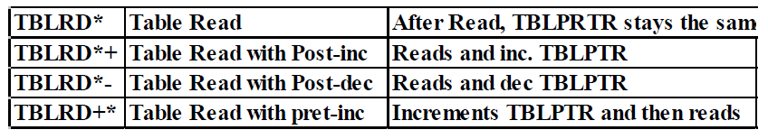
Fixed Data in Program Space
  Is there any instruction to load 21 bits
  MOVLW low MYDATA
  MOVWF TBLPTRL
  MOVLW high MYDATA
  MOVWF TBLPTRH
  MOVLW upper MYDATA
  MOVWF TBLPTRU
  A register to store the read byte TBLAT: keeps the data byte once it is fetched into the CPU. Use instruction TBLRD* to read the data from ROM (put it in TBLLAT)
XXXX stays for some instructions
23
Notes:
23

Slide 24
Example
Write a program to read a byte in MYDATA, and then put it to PORTD
000000 00004 Main ORG 0x0000
000000 6A95 00005 CLRF TRISD
000002 0E18 00006 MOVLW low MYDATA
000004 6EF6 00007 MOVWF TBLPTRL
000006 0E00 00008 MOVLW high MYDATA
000008 6EF7 00009 MOVWF TBLPTRH
00000A 0E00 00010 MOVLW upper MYDATA
00000C 6EF8 00011 MOVWF TBLPTRU
00000E 0008 00012 TBLRD*
000010 50F5 00013 MOVF TABLAT, W
000012 6E83 00014 MOVWF PORTD
00015
000014 EF0A F000 00016 here goto here
00017
000018 0041 00018 MYDATA DB "A"
00019
00020 END

Slide 25
Example
Assume that ROM space starting at 250H contains "Embedded System“, write a program to send all characters to PORTD one byte at a time
000000 00004 Main ORG 0x0000
000000 6A95 00005 CLRF TRISD
000002 0E50 00006 MOVLW low MYDATA
000004 6EF6 00007 MOVWF TBLPTRL
000006 0E02 00008 MOVLW high YDATA
000008 6EF7 00009 MOVWF TBLPTRH
00000A 0E00 00010 MOVLW upper MYDATA
00000C 6EF8 00011 MOVWF TBLPTRU
00000E 0009 00012 B7 TBLRD*+
000010 50F5 00013 MOVF TABLAT,W
000012 E002 00014 BZ EXIT
000014 6E83 00015 MOVWF PORTD
000016 D7FB 00016 BRA B7
000018 EF0C F000 00017 EXIT GOTO EXIT
000250 00018 ORG 0x250
000250 6D45 6562 6464 00019 MYDATA DB "Embedded System",0
6465 5320 7379
6574 006D
00020 END

Slide 26
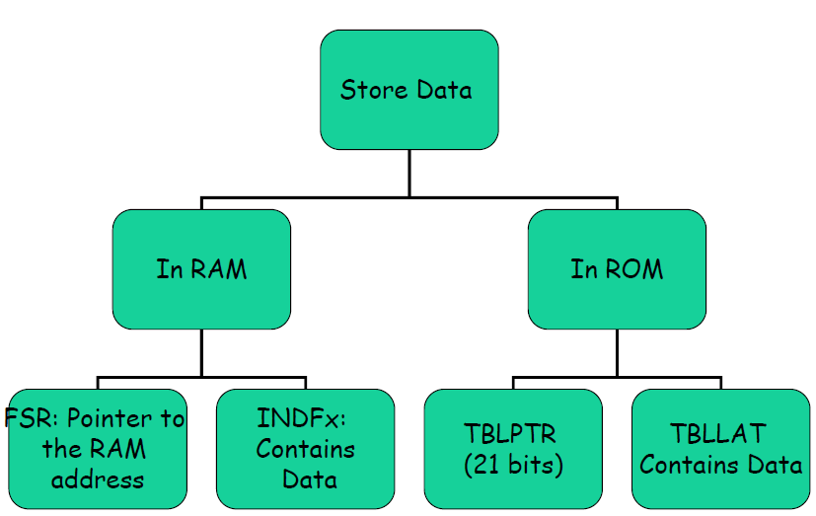
Summary

Slide 27
Look-Up table
Used to access elements of a frequently used with minimum operations
Example: x²
We can use a look-up table instead of calculating the values WHY?
Store the function f(x) in a table (RAM or ROM)
We can get the base address of the table
Input x provides the displacement
Notes:
先不管這些名詞的意義, 先猜猜看有哪些方法可以存取記憶體 ROM 和 RAM.

Slide 28
Look-Up table with RETLW
RETLW (Return from subroutine with Literal to WREG ) will provide the desired look-up table element in WREG
Before execute RETLW, we need to a fixed value (displacement) to the PCL to index into the look-up table. So PC=PC+disp
And the corresponding RETLW is at the PC+disp.
Notes:
先不管這些名詞的意義, 先猜猜看有哪些方法可以存取記憶體 ROM 和 RAM.

Slide 29
Example
Write a program to get x2. Use look-up table instead of a mutliply instruction.
Since RETLW occupies two bytes, we need MULLW 02.
Any potential problem ? ADD does not affect the whole PC.
Main ORG 0x0000 MOVLW d'4' call XSQR_TABLE EXIT GOTO EXIT | XSQR_TABLE MULLW 0x2 MOVFF PRODL, WREG ADDWF PCL RETLW D'0' RETLW D'1' RETLW D'4' RETLW D'9' RETLW D'16' RETLW D'25' RETLW D'36' RETLW D'49' RETLW D'64' RETLW D'81' END
Notes:
1 0000 C0 05 PUSH R5
2 0002 C0 06 PUSH R6
3 0004 C0 E0 PUSH A
1 0000 C0 05 PUSH 05
2 0002 C0 06 PUSH 06
3 0004 C0 E0 PUSH 0E0H

Slide 30
Example
Write a program to get x2. Use look-up table instead of a mutliply instruction. Use TBLAT
Input EQU 0 Main ORG 0x0000 MOVLW d'9‘ MOVWF input call XSQR EXIT GOTO EXIT XSQR MOVLW low XSQR_TABLE MOVWF TBLPTRL MOVLW high XSQR_TABLE MOVWF TBLPTRH MOVLW upper XSQR_TABLE MOVWF TBLPTRU MOVF input, W ADDWF TBLPTRL, F MOVLW 0 ADDWFC TBLPTRH ADDWFC TBLPTRU TBLRD* MOVF TABLAT, W RETURN | ORG 0x0FE XSQR_TABLE db D'0‘, D'1',D'4',D'9', db D'16',D'25',D'36',D'49', db D'64',D'81' END
Notes:
1 0000 C0 05 PUSH R5
2 0002 C0 06 PUSH R6
3 0004 C0 E0 PUSH A
1 0000 C0 05 PUSH 05
2 0002 C0 06 PUSH 06
3 0004 C0 E0 PUSH 0E0H

Slide 31
Look-Up table in RAM
Store data in a continue location
􀂈
Using FSR as a pointer and the working register as an index
􀂈For example:
􀂁MOVFF PLUS2 , PortD
Will copy data from location pointed by FSR2+WREG into PortD
Notes:
先不管這些名詞的意義, 先猜猜看有哪些方法可以存取記憶體 ROM 和 RAM.

Slide 32
Example
Write a program to get x2. Use look-up table instead of a mutliply instruction. Use FSR. FSR provide the base addr. W provide disp.
table equ 0 Main ORG 0x0000 LFSR 0, table MOVLW 0 MOVWF POSTINC0 MOVLW d'1' MOVWF POSTINC0 MOVLW d'4' MOVWF POSTINC0 MOVLW d'9' MOVWF POSTINC0 MOVLW d'16' MOVWF POSTINC0 MOVLW d'25' MOVWF POSTINC0 MOVLW d'36' MOVWF POSTINC0 MOVLW d'49' MOVWF POSTINC0 MOVLW d'64' MOVWF POSTINC0 MOVLW d'81' MOVWF POSTINC0 ;for initialization of the table in RAM | MOVLW d'7' call XSQR EXIT GOTO EXIT XSQR LFSR 0, table MOVFF PLUSW0, WREG RETURN END
Notes:
1 0000 C0 05 PUSH R5
2 0002 C0 06 PUSH R6
3 0004 C0 E0 PUSH A
1 0000 C0 05 PUSH 05
2 0002 C0 06 PUSH 06
3 0004 C0 E0 PUSH 0E0H

Slide 33
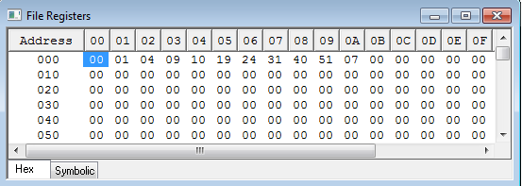
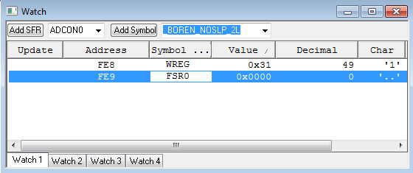
Example
Notes:
1 0000 C0 05 PUSH R5
2 0002 C0 06 PUSH R6
3 0004 C0 E0 PUSH A
1 0000 C0 05 PUSH 05
2 0002 C0 06 PUSH 06
3 0004 C0 E0 PUSH 0E0H

Slide 34
Review: bit-addressability
Often need to access individual bit of the port instead of the entire 8 bits.
PIC18 provides instructions that alter individual bits without altering the rest of the bits in the port.
Most common bit-oriented instructions:
Instructions | Function
bsf fileReg, bit | Bit Set fileReg
bcf fileReg, bit | Bit Clear fileReg
btg fileReg, bit | Bit Toggle fileReg
btfsc fileReg, bit | Bit test fileReg, skip if clear
btfss fileReg, bit | Bit test fileReg, skip if set

Slide 35
Address Mode
Table
Stack and Subroutine Call

Slide 36
Stack and Subroutine Call
In modern computers, we need a stack to store the return address during subroutine call. Besides, we need to save the register values that will be modified by the subroutine.
In the PIC18, we only have a hardware stack for storing return address.
How to solve this problem.

Slide 37
Stack and Subroutine Call
ascii_l EQU 0x0 ;input parameter ascii_h EQU 0x1 ;input parameter out_bcd EQU 0x2 ;output value local_var EQU 0x3 Main program … … … … CALL SUB1 … … … … CALL SUB1 … … | SUB1 … … this routine may modify WREG, STATUS, BSR … … RETURN

Slide 38
Stack and Subroutine Call
Use some locations to store the affected registers
ascii_l EQU 0x0 ;input parameter ascii_h EQU 0x1 ;input parameter out_bcd EQU 0x2 ;output value local_var EQU 0x3 W_TEMP_SUB1 EQU 0x4 Flag_TEMP_SUB1 EQU 0x5 BSR_TEMP_SUB1 EQU 0x6 Main program … … … … CALL SUB1 … … … … CALL SUB1 … … | SUB1 MOVWF W_TEMP_SUB1 MOVFF STATUS, STATUS_TEMP)SUB1 MOVFF BSR, BSR_TEMP_SUB1 … … this routine may modify WREG, STATUS, BSR … … MOVFF BSR_TEMP_SUB1, BSR MOVFF STATUS_TEMP_SUB1, STATUS MOVF W_TEMP_SUB1,W RETURN
Waste resource if we have many routines.
Also, the routines cannot be re-entrence

Slide 39
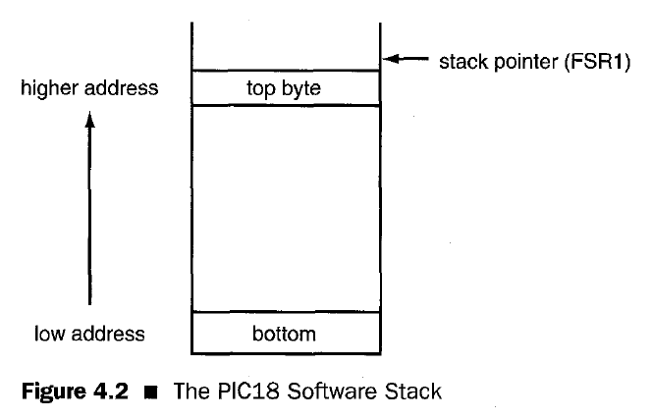
Stack and Subroutine Call
We can use FSR to implement a user stack.

Slide 40
Stack and Subroutine Call
We can use FSR to implement a user stack.
Use LFSR to define a stack
LFSR FSRl, 0x500
The following instruction will push the STATUS register onto the stack:
MOVFF STATUS,PREINCl
The following instruction sequence will pull the top byte of the stack onto the STATUS register:
MOVFF POSTDEC1,STATUS

Slide 41
Stack and Subroutine Call
stack equ 0x200 R0 equ 0 R1 equ 1 R2 equ 2 Main ORG 0x0000 LFSR 0, stack ; define a user stack MOVLW 0x00 MOVWF R0 MOVLW 0x10 MOVWF R1 MOVLW 0x20 MOVWF R2 MOVLW 0x99 MOVFF R0, PRETINC0 ; push R0 to stack FSR0=0201 MOVFF R1, PRETINC0 ; push R1 to stack FSR0=0202 MOVFF R2, PRETINC0 ; push R2 to stack FSR0=0203 MOVFF WREG, PRETINC0 ; push WREG to stack FSR0=0204 MOVLW 0x71 ; Now program change W, R0, R1, R2 MOVWF R0 ; MOVWF R1 ; MOVWF R2 ; ; restore the value from stack MOVFF POSTDEC0, WREG ; FSR0=0203 MOVFF POSTDEC0, R0 ; FSR0=0202 MOVFF POSTDEC0, R1 ; FSR0=0201 MOVFF POSTDEC0, R2 ; FSR0=0200 EXIT GOTO EXIT END

Slide 42
Stack and Subroutine Call
Use stacks store the affected registers
ascii_l EQU 0x0 ;input parameter ascii_h EQU 0x1 ;input parameter out_bcd EQU 0x2 ;output value local_var EQU 0x3 stack EQU 0x200; define a stack Main program LFSR 0, stack … … … … CALL SUB1 … … … … CALL SUB1 … … | SUB1 MOVFF WREG, PREINC0 MOVFF STATUS, PREINC0 MOVFF BSR, PREINC0 … … this routine may modify WREG, STATUS, BSR … … MOVFF POSTDEC0, BSR MOVFF POSTDEC0, STATUS MOVFF POSTDEC0,WREG RETURN
In general, modern computer systems use stack to pass parameters
and to handle local variables. But the procedure is very complicated.
If you are interested in this issue, read
PIC Microcontroller: An Introduction to Software & Hardware Interfacing
Chapter 4.

